Slide 1

Chicago: Marijuana and other Narcotics
Tabor Beaudry

Slide 2
DATASET:
This is an analysis of one of the many public datasets hosted by the city of Chicago. The Chicago Criminal Incident Reports 2001-2015 contains roughly 6 million entries with very few corrupted or missing values that were easily sorted out.
Each Incident contains
Identifier information: Case Number, Incident Number, Date Reported etc.
Location Information: Block, District, Ward, Latitude and Longitude etc
Incident Details: Description (categorical), Primary Type, Booleans Arrest? and Domestic etc.
Research is primarily focused on Primary Type: Narcotics specifically exploring the differences in this data between Marijuana and other Narcotics

Slide 3
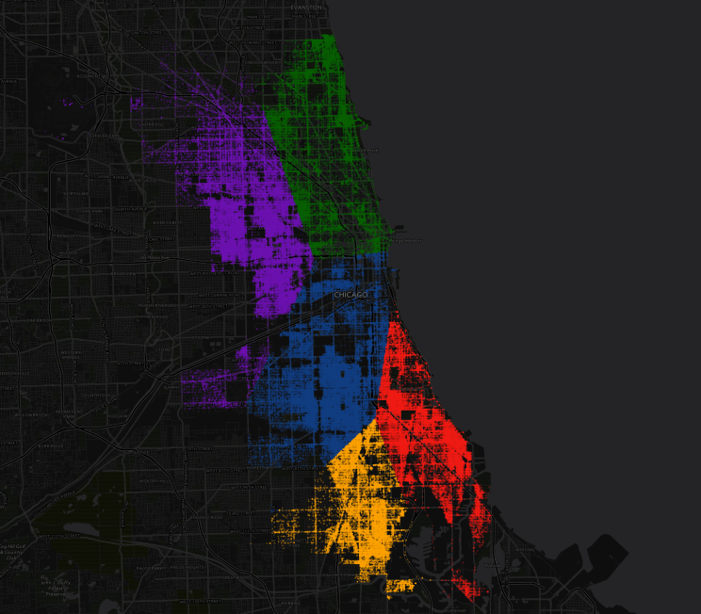
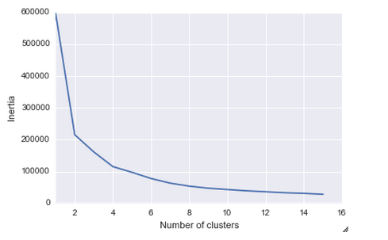
HYPOTHESIS:
Examination of geographical distribution of many Narcotics will show clear shifts in frequency and location however incidents involving Marijuana will not.
To achieve this, incidents involving specific narcotics will be clustered (using kmeans) upon geographical location so that we can examine trends on a geographical basis
5 Clusters were chosen based off of the kmeans error

Slide 4
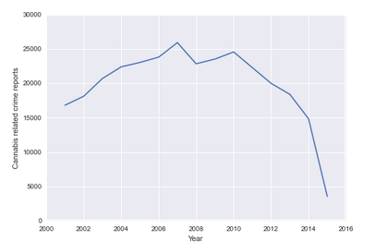
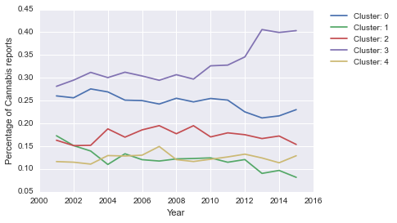
Result: Marijuana
Marijuana along with other Narcotics all show shifts in distribution
The percentage of Cannabis Reports vs all Cannabis Reports per cluster shows definitive geographical transitions. Cluster 1 lost ~ 10% of the activity over the entire period. Cluster 3 and Cluster 0 traded a significant amount of activity since 2011

Slide 5
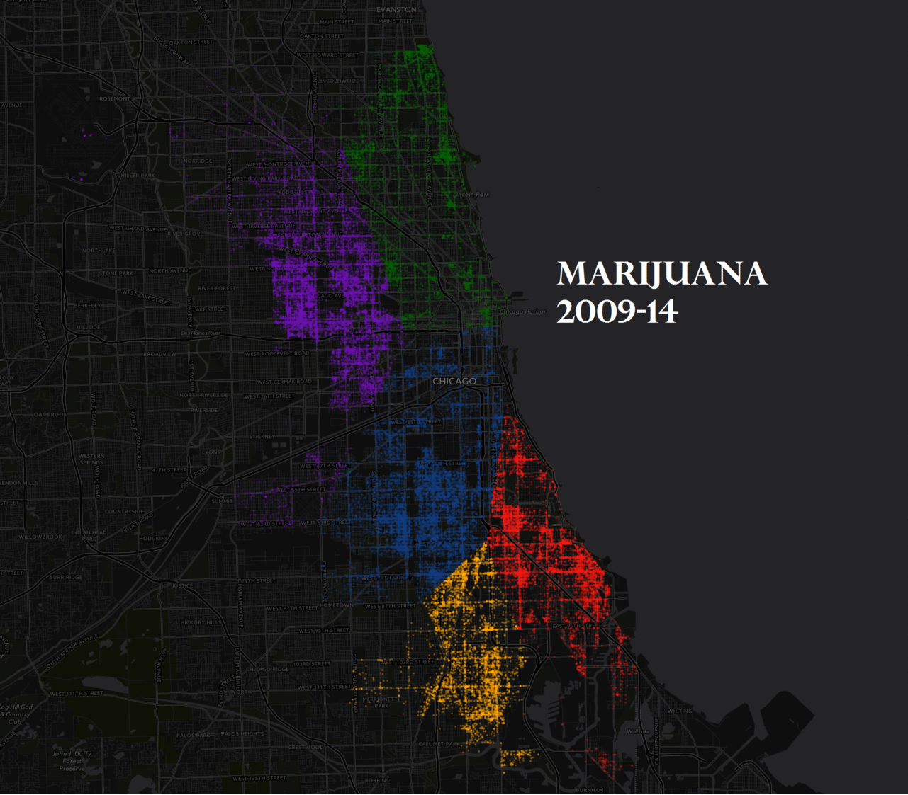

Slide 6
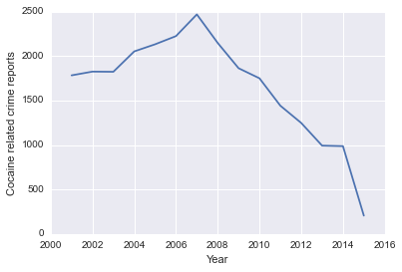
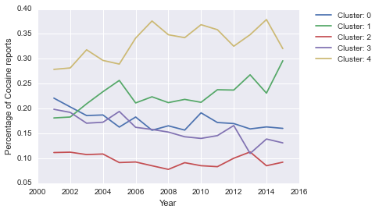
Result: Cocaine
Cluster 3 tends downwards over the whole span while Cluster 1 trends fairly upwards along with Cluster 4. Overall Usage is significantly reduced across the city

Slide 7
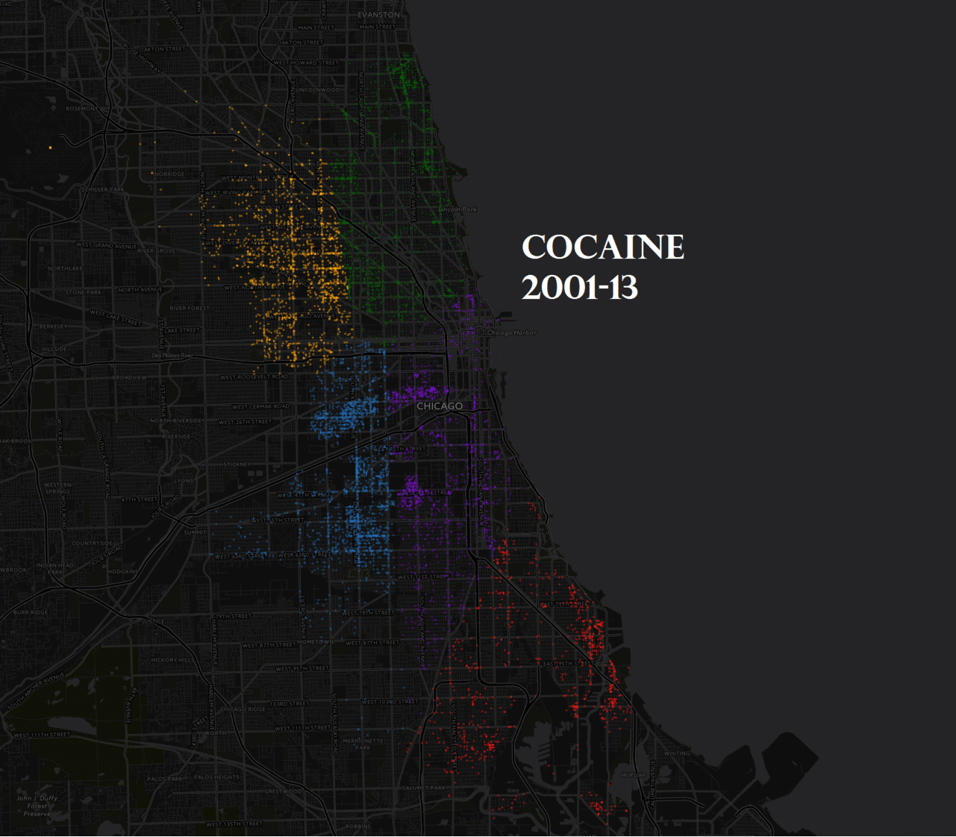

Slide 8
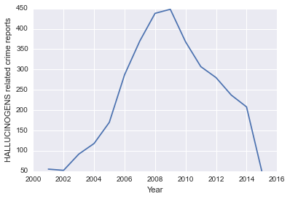
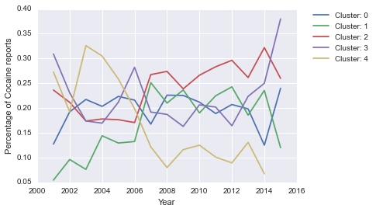
Results: Hallucinogens
This case is particularly interesting because you can see some clusters where the drug hit first before becoming more popular in other areas. Cluster 4 for example has quite a large percentage of reports then drops extremely quickly. Cluster 1 gains similarly with the overall rate until remaining approximately constant

Slide 9
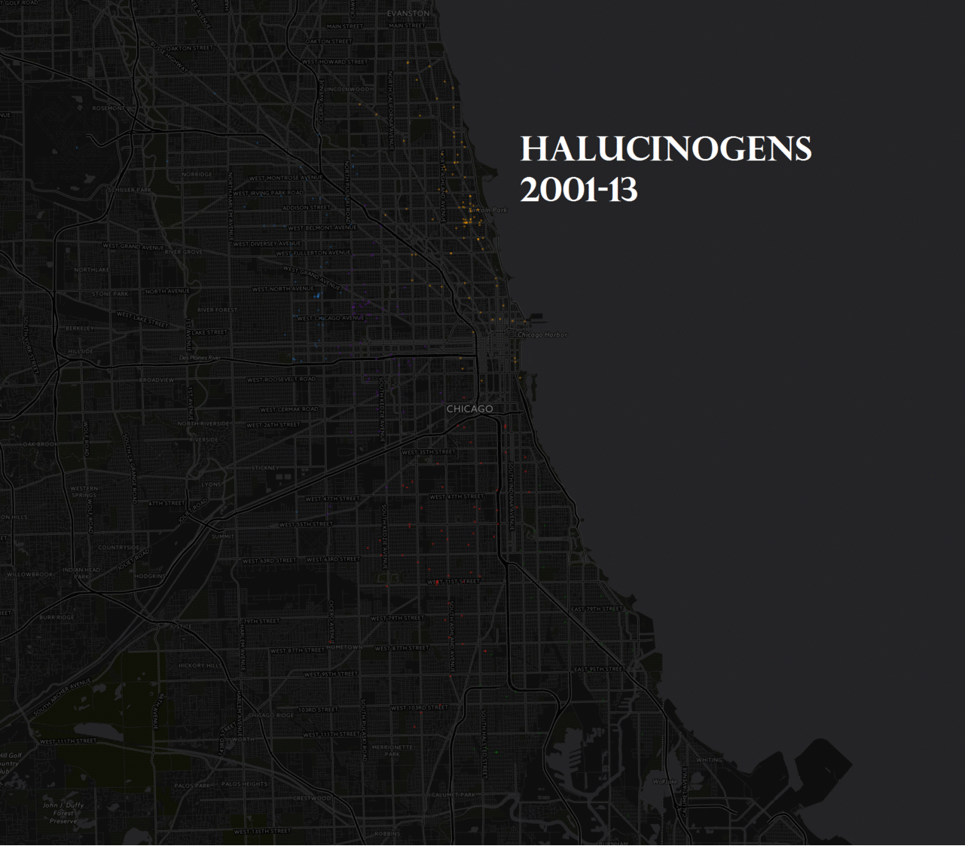

Slide 10
HYPOTHESIS
Marijuana incidents are linearly correlated with the occurrences of other specific crimes by ward. This correlation will be compared with incidents involving Brown/Tan Heroin correlated with the same specific crimes for reference.
Specific Crimes Examined:
Aggravated Assault with Handguns
Forced Entry
Soliciting Narcotics in Public
Theft of Labor Services
Each point on the plots is a Ward with coordinate (#Marijuana Incidents, #Specific Other)

Slide 11
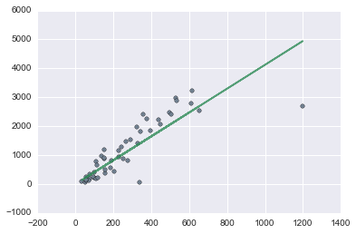
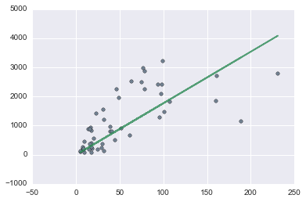
RESULTS: AGGravated Handgun
Marijuna Brown/Tan Heroin
Coefficent of Determination for Marijuana is .884 while only .748 for Heroin.
Linear Regression for Marijuana incidents vs Aggravated Assaults with Handguns are fairly well correlated

Slide 12
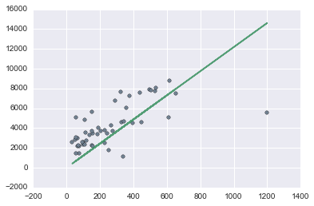
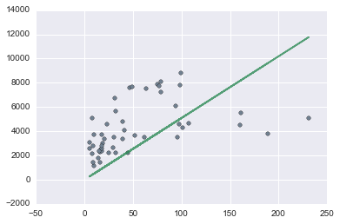
RESULTS: FORCEd ENTRY
Marijuna Brown/Tan Heroin
Once again Marijuana is a better predictor of Forced Entry incidents than Heroin

Slide 13
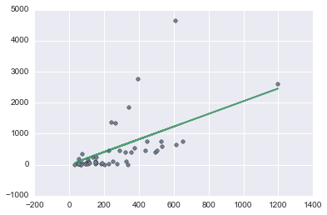
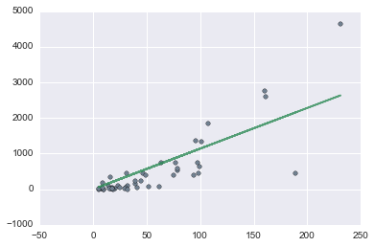
RESULTS: Soliciting in public
Marijuna Brown/Tan Heroin
This time Heroin is actually a better predictor than Marijuana with an R^2 of .73 vs an R^2 of .512

Slide 14
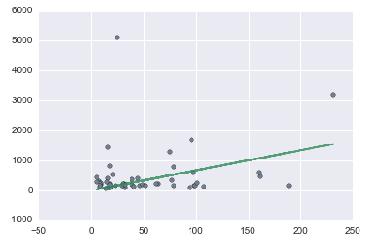
RESULTS: Theft of Labor Services
Marijuna Brown/Tan Heroin
Theft of Labor Services correlates very poorly with both Marijuana and Heroin with R^2 values of .251 for both regressions.

Slide 15
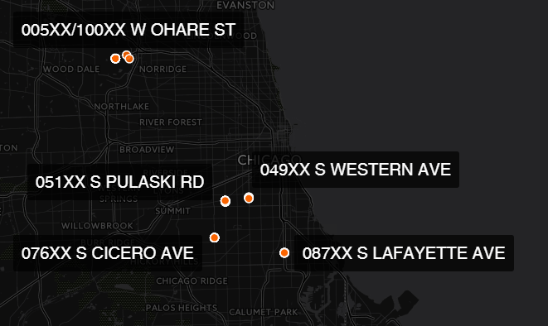
ADDENDUM: WORST PLACES TO PARK IN THE CITY OF CHICAGO
Lafayette and Western have some of the highest rates of vehicular crimes to other crimes
Ohare and Cicero have the largest amount of vehicular crimes and are violent areas in general
Pulaski has the largest amount of vehicular crimes for an areas with somewhat less general crime than the previous two

